Slide 1
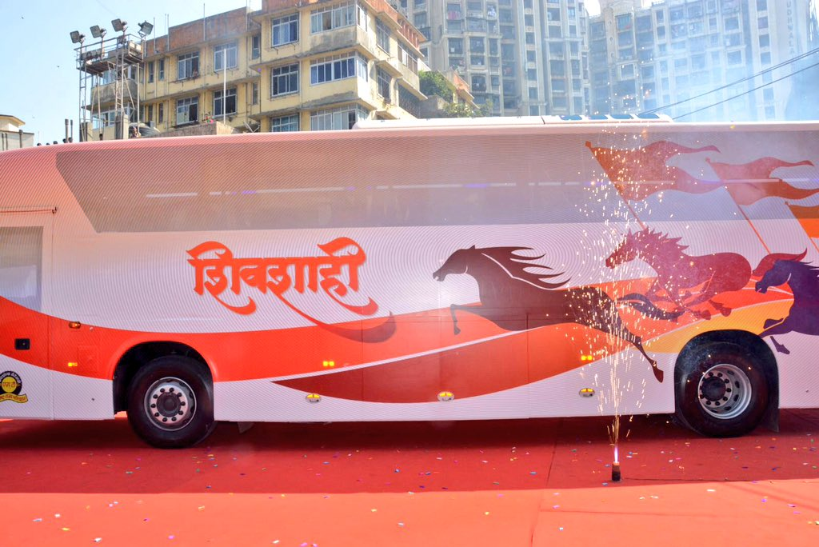
ONLINE BUS BOOKING SYSTEM GROUP- 08

Slide 2
TEAM MEMBERS
Employee ID | Name
2507843 | T Jagadeesh (Front End Lead)
2505730 | Thalla Vinay
2506587 | Thyadi Sai Chandrakala (Back End Lead)
2506399 | Uppala Prudhvi Raj
2504179 | Uppalapati Keerthi
2508085 | Varawate Pratiksha Raghunath
2504360 | Veeksha T
2507121 | Vemuri Lakshmi Sravani
2504410 | Vinayak Rajaram Shinde
2504781 | Yenduri Naga Teja (Team Lead)

Slide 3
TEAM DISTRIBUTION
Front End Team
T Jagadeesh
Varawate Pratiksha Raghunath
Veeksha T
Vinayak Rajaram Shinde
Yeduri Naga Teja
Back End Team
Thalla Vinay
Thyadi Sai Chandrakala
Uppala Prudhvi Raj
Uppalapati Keerthi
Vemuri Lakshmi Sravani

Slide 4
MODULES
FRONTEND:
User and Admin Login, Add Bus Details
Ad Passengers, Admin Services
Admin Form, Bus Update, Update Passengers, Update Passengers, Update User Details
User Form, User Register, View All Bus Details, View User Details
BACKEND:
Controller
DAO
Entity
Exception
Services
Service LMPL
Utilities
Security

Slide 5
INDEX
Introduction
Scope
Modules
Technologies
Flow Diagrams
Angular & Its Architecture
Spring Boot & Its Architecture
Application Interfaces
Advantages
Features
Conclusion

Slide 6
INTRODUCTION
The bus booking system is a Java Spring Boot, MySQL and Angular Project which runs on the tomcat server, you can also run this project eclipse and Spring Tool Suites. We also developed this java Spring Boot and Angular project on Bus Booking System to automate the process. The main features of this project are to manage Bus, Ticket Booking, Sales, Operations, Customers and Booking.
The Online Bus Booking System is a web-based application that allows visitors to check ticket availability, buy a bus ticket and pay for the bus ticket online.

Slide 7

SCOPE
The scope of the online bus booking system is: A person should be able to:
Login to the system through the first page of the application.
Otherwise we can register into the system.
Should be able to create a new login for accessing the reservation facility.
Able to choose the seats which are available for a certain class.

Slide 8

MODULES OF BUS BOOKING SYSTEM
Bus module: We can manage all the operations related to Buses from this module.
Ticket Booking module: This module is normally developed for managing the Ticket Booking operations.
Operations module: This module manages Operations functionalities.
Admin module: Admin modules perform all the create, read, update and delete operations of bus application facilities.
Booking module: It manages all the functionalities of Booking.
Customer module: Register, login, booking.

Slide 9
TECHNOLIGIESUSED IN PROJECT:
Frontend:
VisualStudio Code IDE
Node js & Npm
TypeScript
Angular CLI
Backend:
Spring Boot
Maven
Spring Data JPA
JDK 1.8
Embedded Tomcat server
MySQL Database

Slide 10
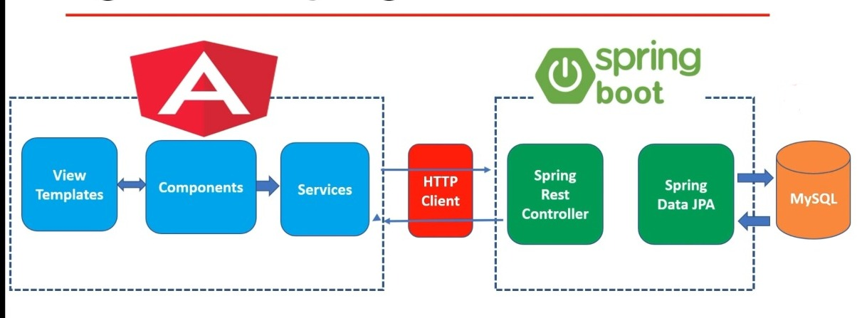
WEB APPLICATION BLOCK DIAGRAM

Slide 11
ANGULAR:
Angular is a platform and framework for building single-page client applications using HTML and TypeScript. Angular is written in TypeScript.
Great for Single page applications.
Angular is modular.
Built-in features DI, data binding etc.

Slide 12
ANGULAR APPLICATION ARCHITECTURE
The architecture of an angular application relies on certain fundamental concepts. The basic building blocks of the angular framework are angular components that are organized into Ng modules. Ng modules collect related code into functional sets; an angular application is defined by a set of Ng modules. An application always has at least a root module that enables bootstrapping and typically has many more feature modules.
Modules, components and services are classes that use decorators. These decorators mark their type and provide how to use them.
An application’s components typically define many views, arranged hierarchically. Angular provides the Router service to help you define navigation paths among views. The router provides sophisticated in-browser navigational capabilities.

Slide 13
SPRING BOOT:
Spring boot to develop REST web services.
Spring Boot has taken the Spring framework to the next level. It has drastically reduced the configuration and setup time required for spring projects.

Slide 14
SPRING BOOT APPLICATION ARCHITECTURE
The Spring Boot is built on top of the core spring framework. It is a simplified and automated version of the spring framework. The spring boot follows a layered architecture in which each layer communicates with other Layers. The spring boot documentation provides the following definition of the spring boot framework.
“Spring Boot makes it easy to create stand-alone, production-grade Spring-based application that you can just run”
The main aim of spring boot is to remove the XML and annotation-based configurations. This spring provides the following benefits such as opinionated, convention over configuration, stand-alone, and production-ready.

Slide 15
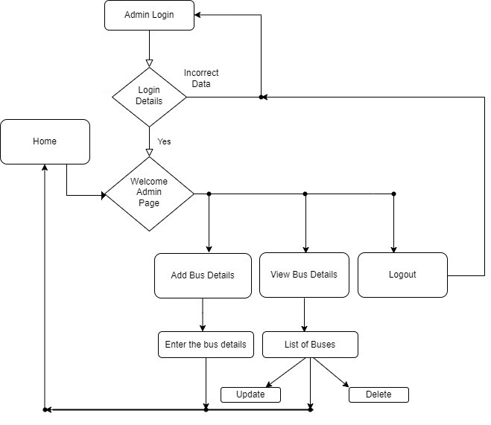
Work Flow Diagram

Slide 16
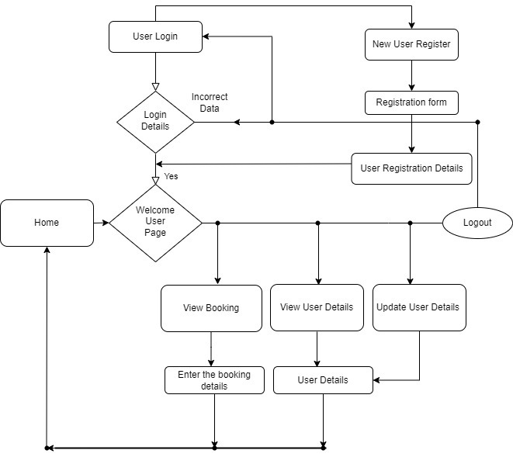
Work Flow Diagram

Slide 17
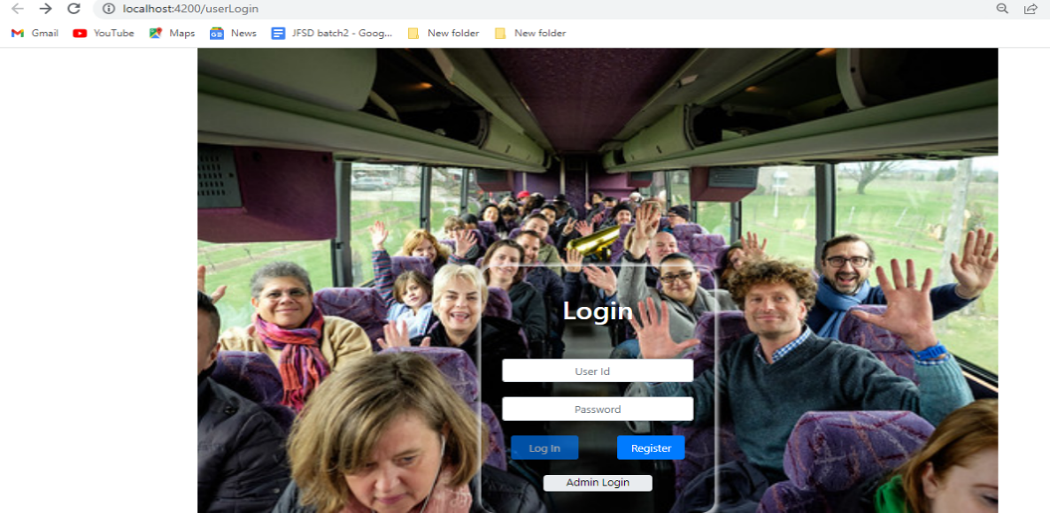
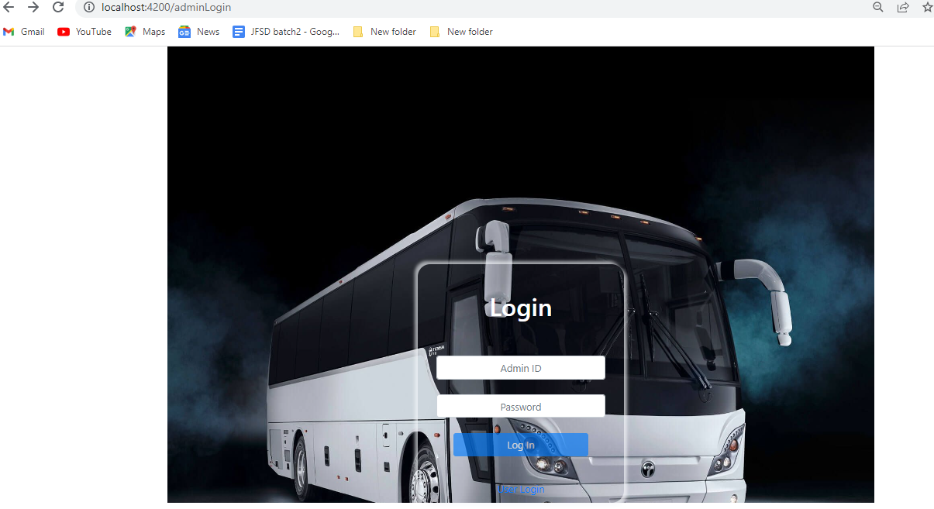
OUTPUT
User Login
Admin Login

Slide 18
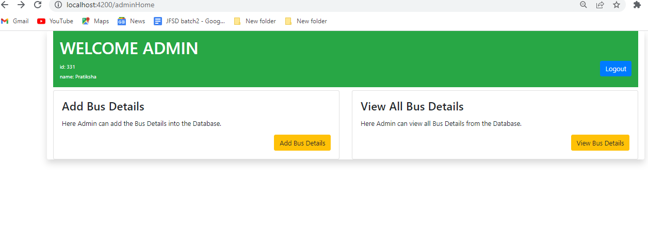
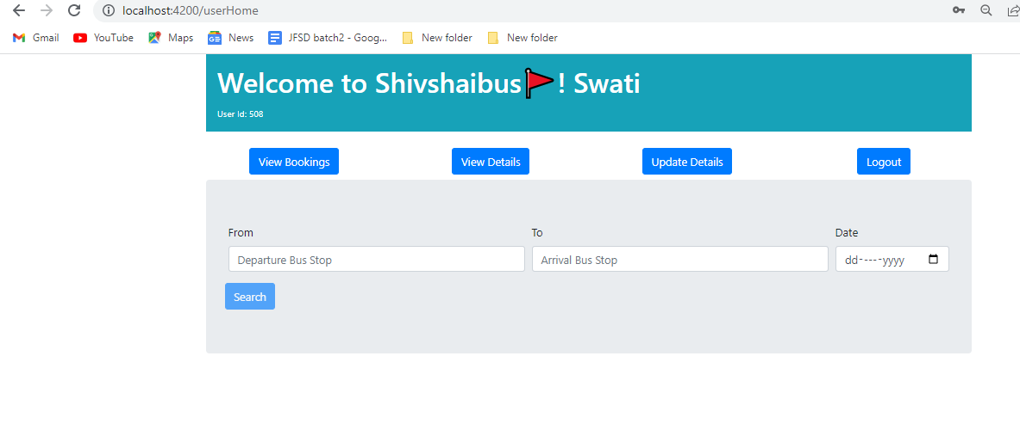

Slide 19
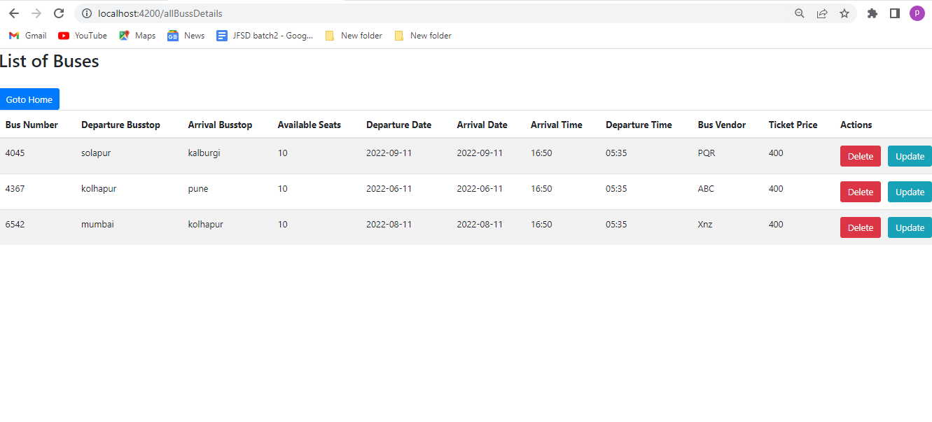

Slide 20
ADVANTAGES
Good customer service
Commission Free
Open 24/7 for reservation
Discount codes
Clear and simple process
Seat of your own choice

Slide 21
FEATURES
It simplifies the tasks and reduces the paper work.
Accuracy.
Availability.
User Friendly.
Efficiency.
Reliable.

Slide 22
CONCLUSION
The online ticket booking system is an application where the customer can book a ticket online and 24/7 hours a day from any place in the world. Customers can also interact with the ticket booking website to know any other details they want. The online ticket booking system has developed successfully. System performance was also found to be satisfactory. This is a user-friendly application. Through this application, the cost can be reduced and efficiency is increased. With help of this application, customers can book tickets, and can know the status of the bus.

Slide 23
Thank You !!!

